Slide 1
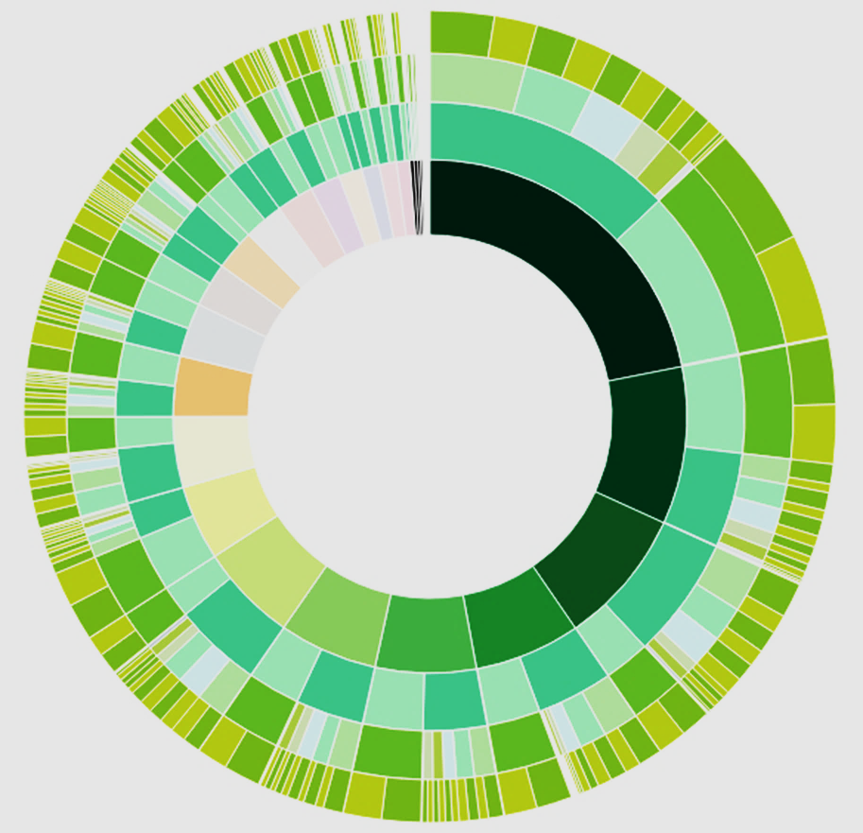
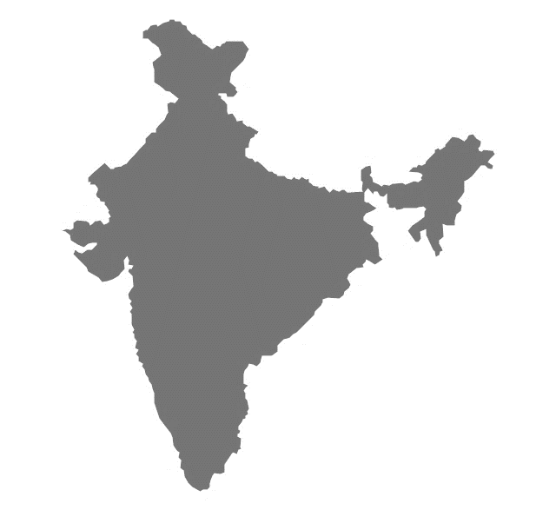
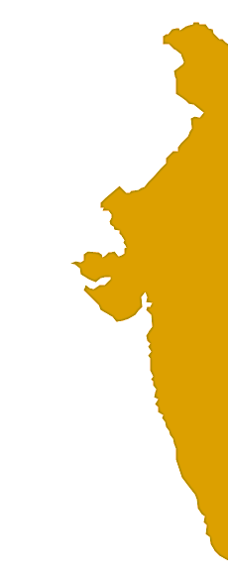

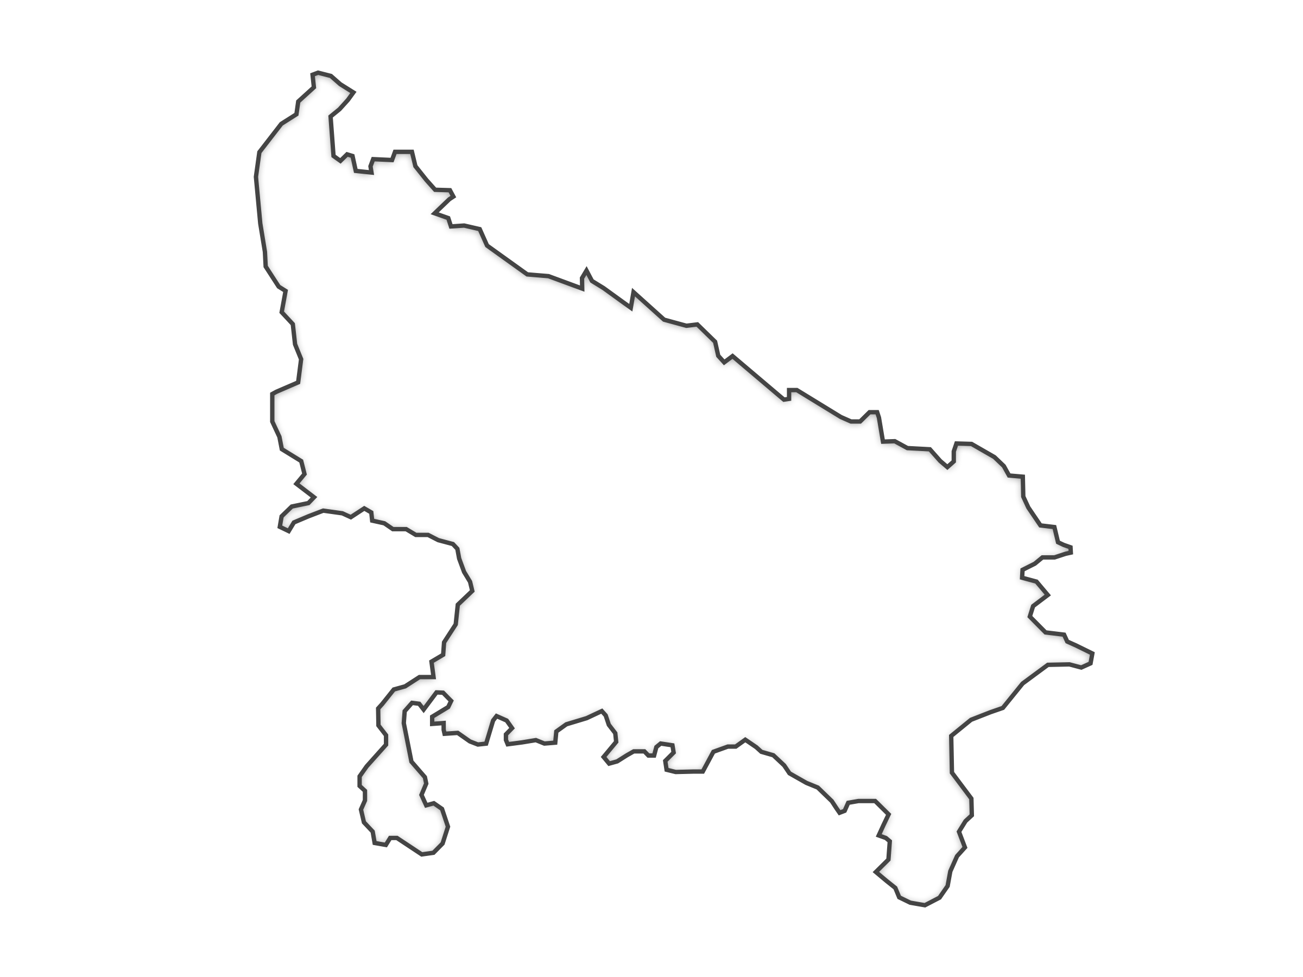
Census India
Literacy And Level of Education
2.9K Literate
1.3K Illiterate
2:3 Male Female Ratio
77%
57%
Literacy is at the heart of basic education for all, and essential for eradicating poverty, reducing child mortality, curbing population growth, achieving gender equality and ensuring sustainable development, peace and democracy
Age-wise Literacy split
0-18
3%
19-25
8%
26-35
7%
36-45
6%
46 and above
2%
Education Level Split
35%
20%
20%
10%
15%

